Slide 1
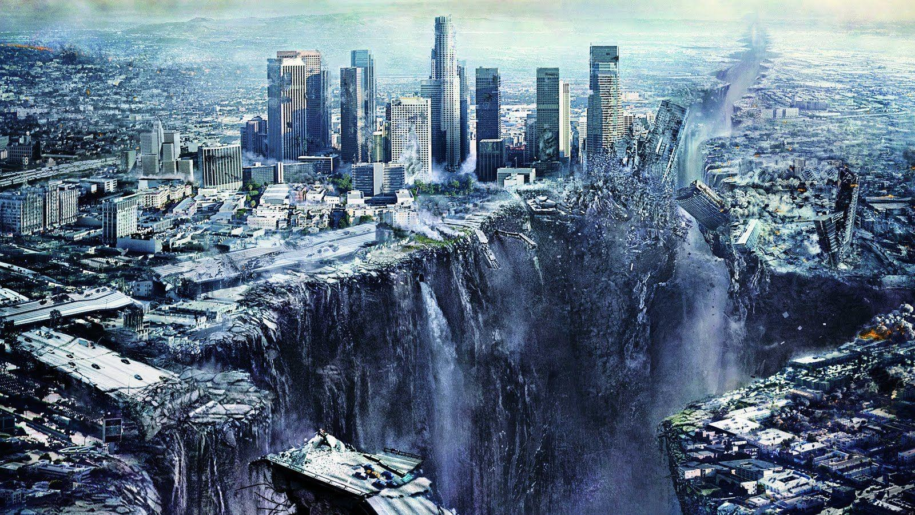
Seismic Preparedness for the General Public Using Virtual Reality
Presented by Chen Zhao and Edwin Roesli
Supervised by Dr Nasser Giacaman and Dr Quincy Ma

Slide 2


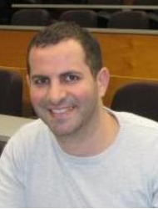

Our Team
Introduction
Literature Review
Methodology
Result
Conclusion
Chen Zhao
Edwin Roesli
Dr Nasser Giacaman
Dr Quincy Ma

Slide 3
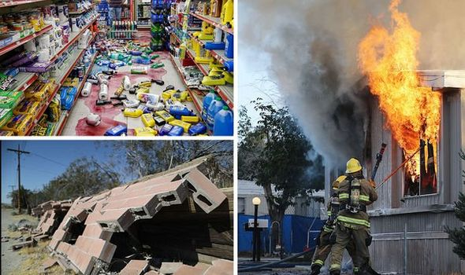
Motivation
Introduction
Literature Review
Methodology
Result
Conclusion
Earthquake can cause mass damage to the local area.
People get injured from Earthquake.
Many initiatives on raising earthquake awareness.
Few initiatives focus on object hazard identification.
Therefore, we built a VR application, aiming for teaching people hazard identification concepts.
Notes:
Talk about the dangers of Earthquakes “natural disaster that can affect millions of lives”
Survey says people are injured due to objects that are not secured enough, following that another survey suggests that 63% amount of people have not secured their furniture

Slide 4


Project Goals
Introduction
Literature Review
Methodology
Result
Conclusion
Effectiveness of Training: Identify the effectiveness of learning between VR training and reading a guide.
How do properties of game objects impact their behaviour during an earthquake simulation

Slide 5
Related work
Introduction
Literature Review
Methodology
Result
Conclusion
Majority of VR earthquake simulator work focused on:
Evacuation in the case of an earthquake
Safety precautions
Complete immersion, experience an earthquake without the physical injuries
What we did differently:
Specific object interactions during an earthquake
Notes:
Talk about a general idea of VR related projects
Talk about how our work/ project differs from other projects (They focus on evacuation/ rooms interaction on a greater scale, whereas we focus on the specific object interactions)

Slide 6

Research
Introduction
Literature Review
Methodology
Result
Conclusion
Multiple experiments conducted within Unity to determine an objects behaviour during an earthquake. Some experiments include the interactions between:
Cuboid based structures and cylindrical based structures
Objects of different densities
Objects placed on top of different heights
Objects placed on top of stacked or non stacked objects
Objects with varying heights

Slide 7
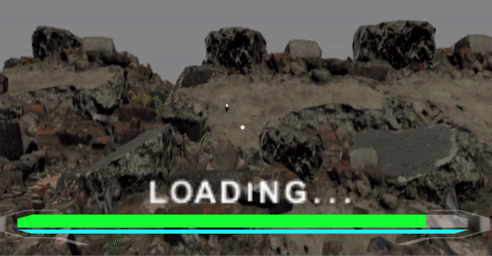
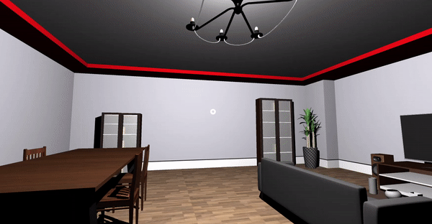
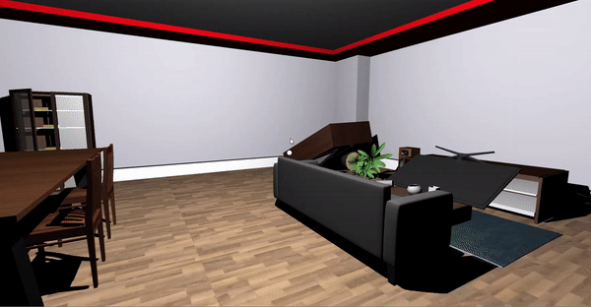
Mobile Virtual Reality Application
Introduction
Literature Review
Methodology
Result
Conclusion
Training in the virtual reality application comes in three stages:
Object hazard analysis
Earthquake simulation
Object hazard evaluation

Slide 8
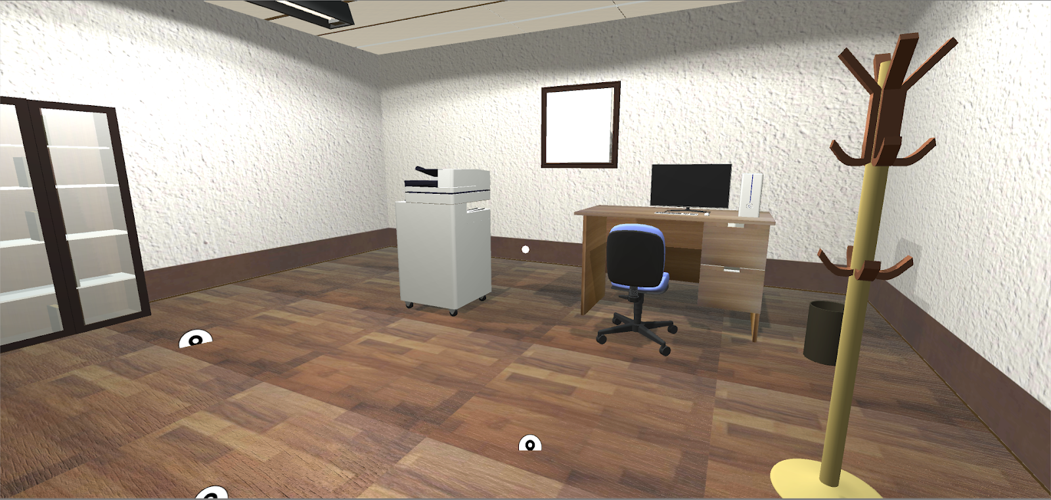
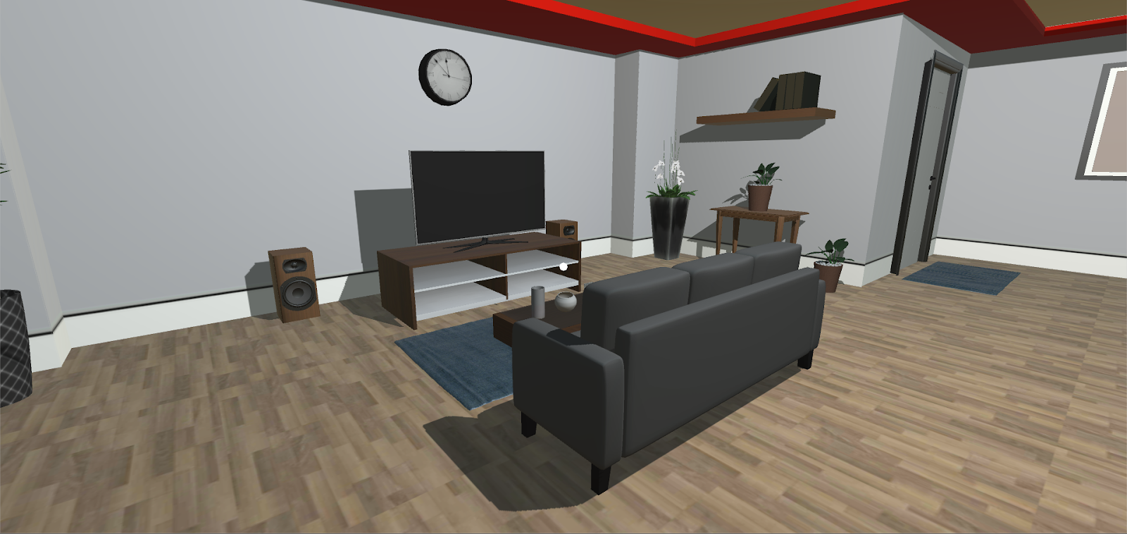
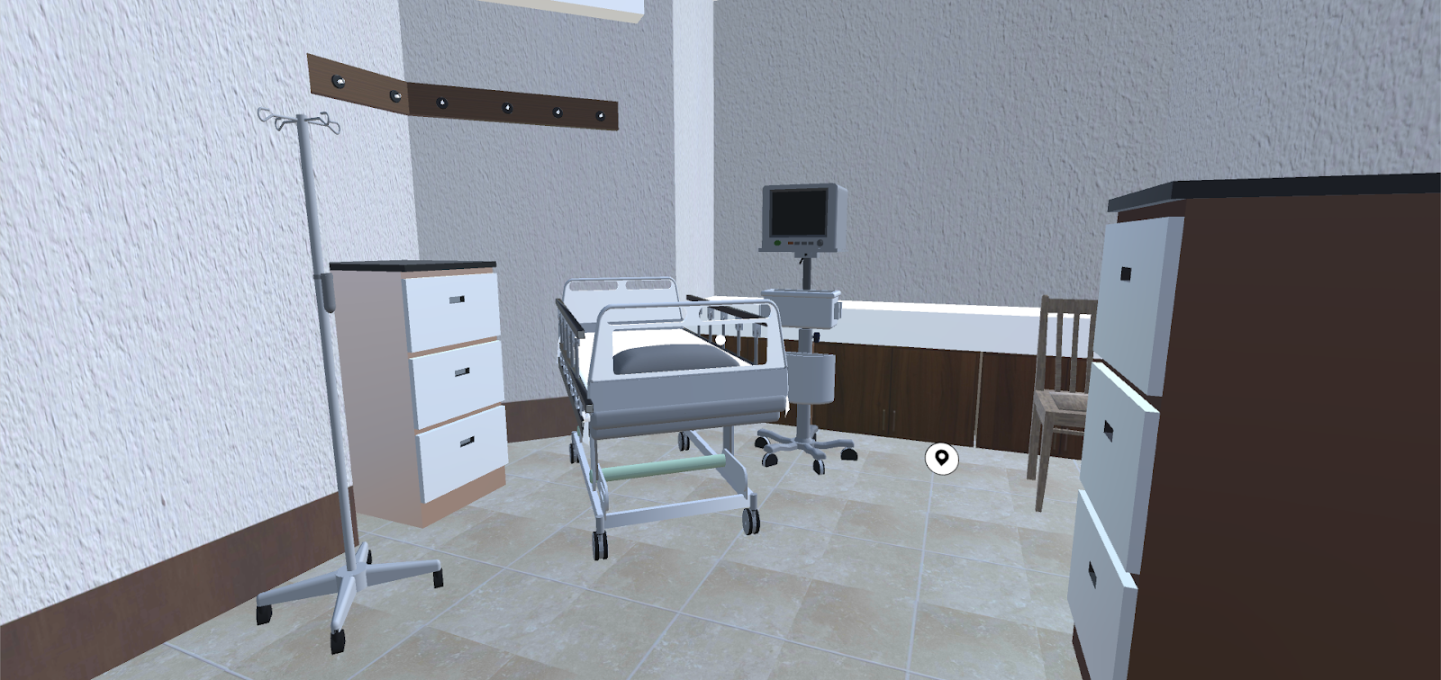
Mobile Virtual Reality Application
Introduction
Literature Review
Methodology
Result
Conclusion
Mobile application consists of 3 stages for the user to be immersed in
Office scene
Living room scene
Hospital scene

Slide 9
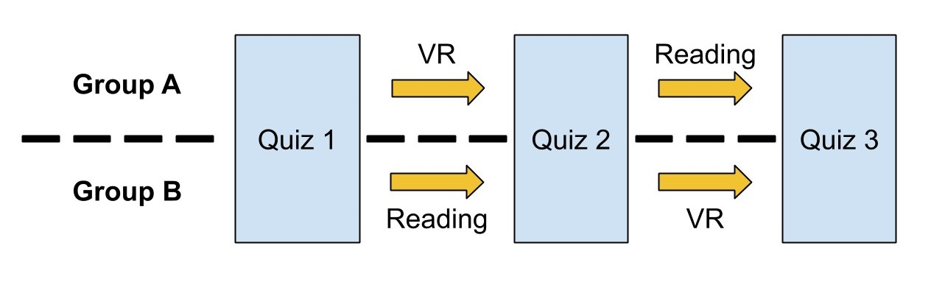
User Evaluation Overview
Introduction
Literature Review
Methodology
Result
Conclusion
Users are split into 2 groups, reading first and VR training first
Statistically analyse the differences in learning effectiveness of users between the 2 groups
The last quiz acts as an opportunity for everyone to try VR and compare whether or not people have genuinely learnt how objects behave under an earthquake.
Notes:
For our user evaluation, we split our participants into two groups. As you can see in the flow chart, both group needs to complete three quizzes in our user evaluation. However, the first group did VR training first and then followed by the instruction reading, while the second group did them in a reverse order. The reason why we constructed our user evaluation was to eliminate the biases in our user evaluation. As there are two groups of users, we compared these two groups individually and separately to determine whether the VR training is effective or not.

Slide 10
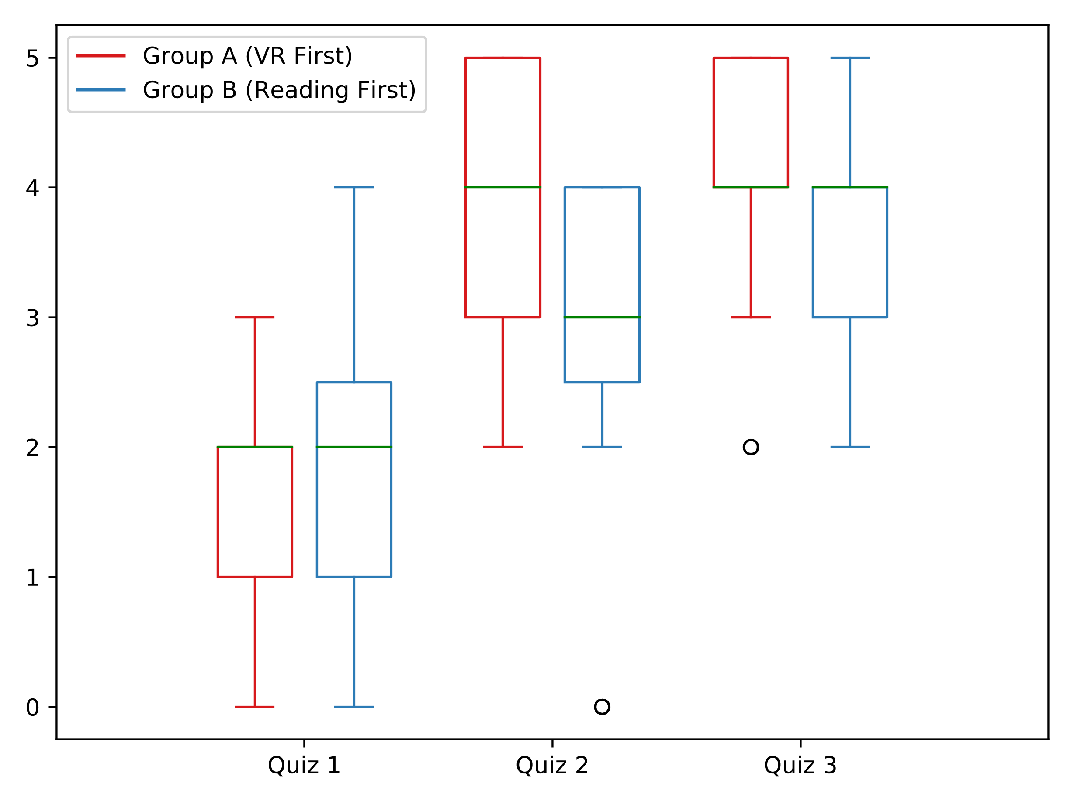
User Evaluation Result
Introduction
Literature Review
Methodology
Result
Conclusion
Both Groups have improvement on learning
Group A has greater improvement compared to Group B
Both groups reach the same knowledge level eventually.
Notes:
We used statistical analysis to compared the user evaluations within each group and between the groups. We used Mann-Whitney U test to determine whether there is a significant difference between the result and Wilcoxon ranked test to determine whether there is a significant improvement within the groups. According to the statistical analysis, the two groups have the same knowledge level on hazard identification at the beginning. Both groups have improvements in performance in quiz 2 but the VR first group has better performance. In the end, they reach the same knowledge level.

Slide 11
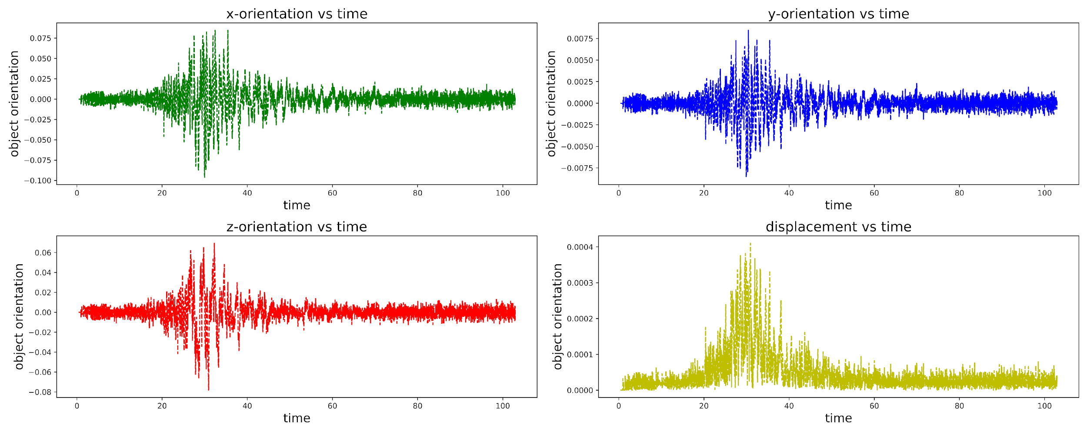
Research Result
Introduction
Literature Review
Methodology
Result
Conclusion
Cuboid structures are more stable
Higher density objects are less stable
Objects placed at a lower height are more stable than ones placed on a higher height
Objects that are placed on top of multiple stacked objects are more unstable
Taller objects are more unstable compared to shorter objects
Notes:
As Edwin mentioned previously, we attached a script to the objects we did experiment on and generated the time vs displacement graph, which is similar to the one over there. We determine the stableness of the object by observing the maximum distance and the vibration frequency through the graph. The results are shown on the right hand side of this slide.

Slide 12
Conclusion
Introduction
Literature Review
Methodology
Result
Conclusion
Mobile VR application VS Reading Instructions
Objects with different properties interact with an earthquake differently, more specifically:
Both Mobile VR and reading instructions are effective in teaching earthquake preparedness concepts
But mobile VR applications are more effective in teaching earthquake preparedness concepts compared to reading instructions.
Cuboid structures are more stable
Higher density objects are less stable
Objects placed at a lower height are more stable than ones placed on a higher height
Objects that are placed on top of multiple stacked objects are more unstable
Taller objects are more unstable compared to shorter objects
Notes:
Overall,from our user evaluation, which answers our first research question, both mobile VR training and reading instructions are effective on learning hazard identification concepts, but mobile VR training is more effective compared to reading instructions. From our research result, which answers our second research question, cuboid structures, low density object, objects placed at the bottom and short objects are tend to be stable in an earthquake simulation.

Slide 13

Future Work
Introduction
Literature Review
Methodology
Result
Conclusion
More variety of magnitudes of earthquakes
Including breakable furniture models and immersive sound effect to the scene.
Data analysis of user camera positions and rotations.
To provide a better VR experience.
Notes:
Due to the limited time on building our application, we did not have enough time to implement the aspects listed above. These may leave as the future work for this project.

Slide 14

Questions
Thanks for listening. Any questions?

